Slide 1

Fiori Development
Kevin zhang
2016
@lenovo.com

Slide 2

Agenda
After this course, you will understand:
How to Develop Fiori app
SAP Fiori Introduction
SAP Fiori Architecture Overview
SAP Fiori Development Prepare
Back-end Development
Front-end Development
Helpful Resource in SCN

Slide 3
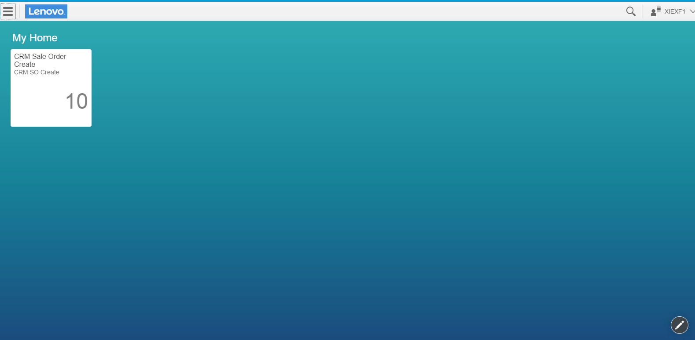

SAP Fiori introduction
SAP Fiori is a collection of Web applications that are designed to run on desktop and mobile. This means that a single instance of the application supports end users regardless of the device they are using.
Currently more than 700 apps for broadly and frequently used SAP software functions have been launched, and more will be available in future.
Fiori Library:
https://fioriappslibrary.hana.ondemand.com/sap/fix/externalViewer/#
Official Reference : http://help.sap.com/Download/Multimedia/fc16/9e8f5f0f54fb476887728c781604f6c6.html
http://help.sap.com/fiori

Slide 4
Agenda
After this course, you will understand:
How to Develop Fiori app
SAP Fiori Introduction
SAP Fiori Architecture Overview
SAP Fiori Development Prepare
Back-end Development
Front-end Development
Helpful Resource in SCN

Slide 5

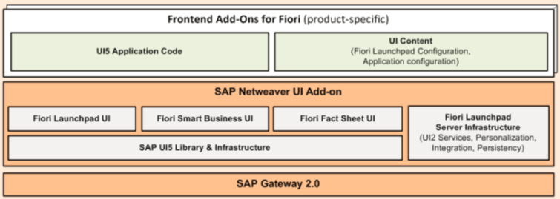
SAP Fiori Architecture Overview
Firewall
New
New
Web Dispatcher
Front-End Server (NW ABAP)
HTTPS(HTML/ODATA)
Customizing UI & Role
New
Front-End Server (NW ABAP)
RFC
Back-End Server (NW ABAP)
SAP Business Suite
ECC
SCM
SRM
Customizing RFC
Customizing RFC
Customizing RFC

Slide 6
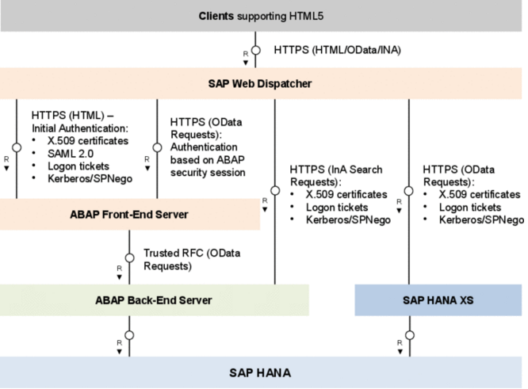
SAP Fiori Architecture Overview

Slide 7
Agenda
After this course, you will understand:
How to Develop Fiori app
SAP Fiori Introduction
SAP Fiori Architecture Overview
SAP Fiori Development Prepare
Back-end Development
Front-end Development
Helpful Resource in SCN

Slide 8
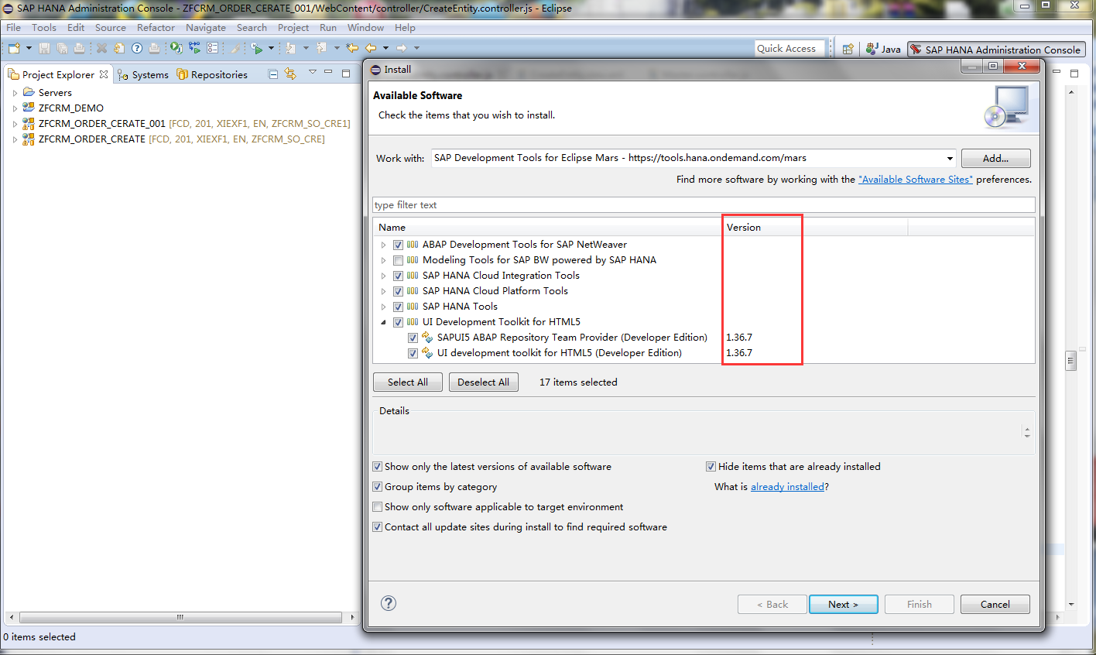
SAP Fiori Development Prepare---Front-end
1
Eclipse/HANA studio
Mars or Luna
UI Version
2
3

Slide 9
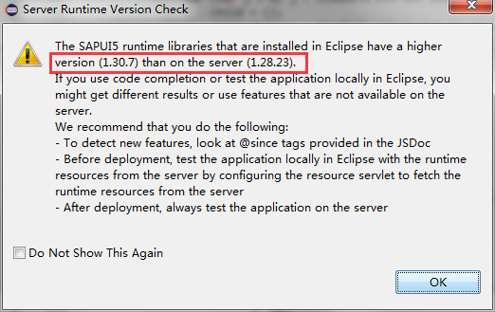
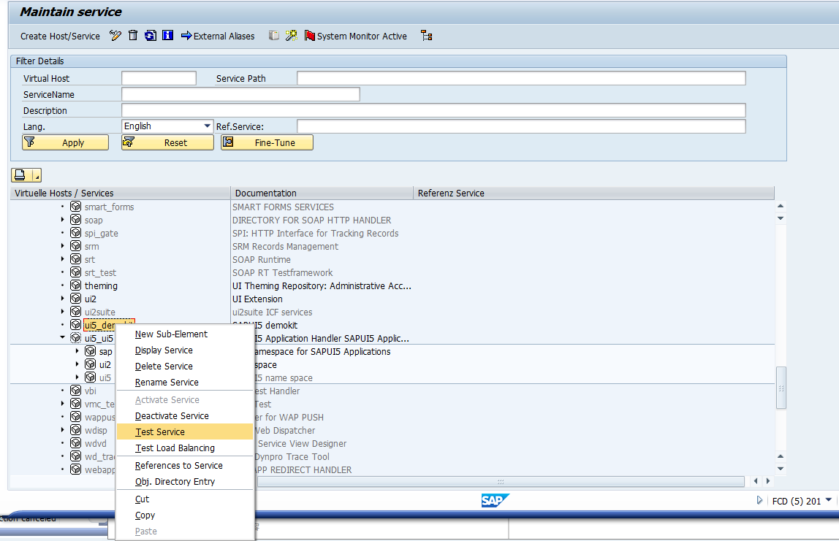
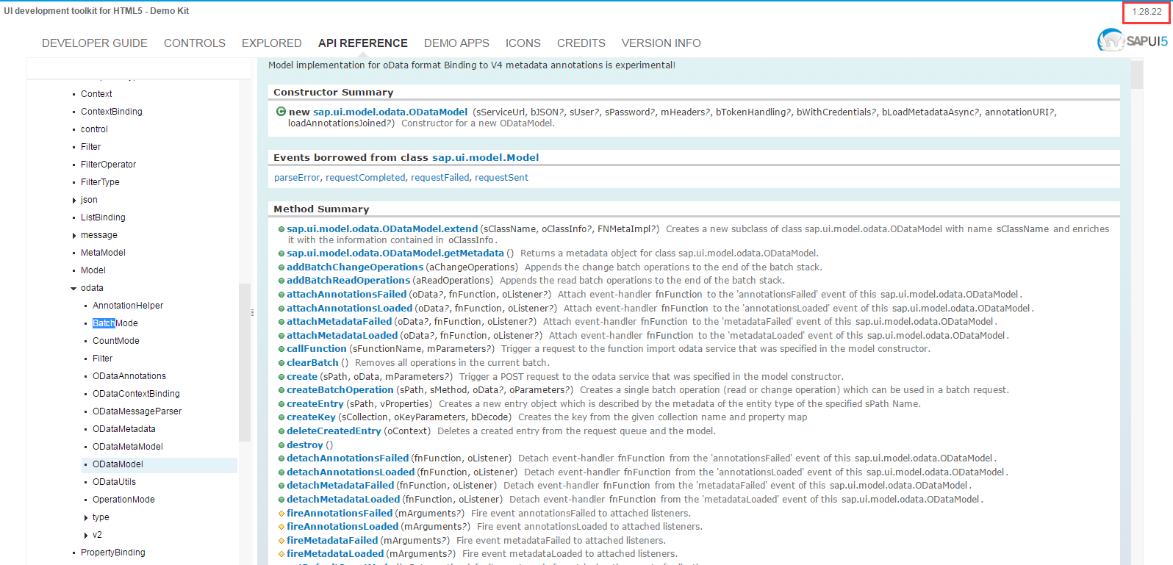
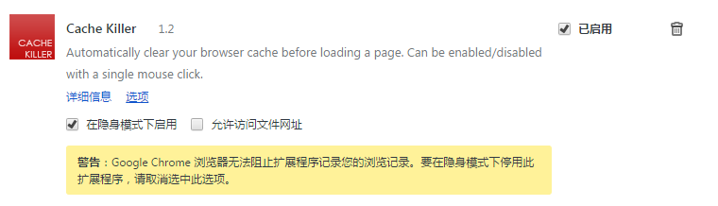
SAP Fiori Development Prepare---Front-end
The UI version you install always be the lastest, so when you have to notice the version check
You have to develop the UI5 application base on the server SDK(T-code:SICF)
Browser with catch killer plug-in
1
3
2

Slide 10
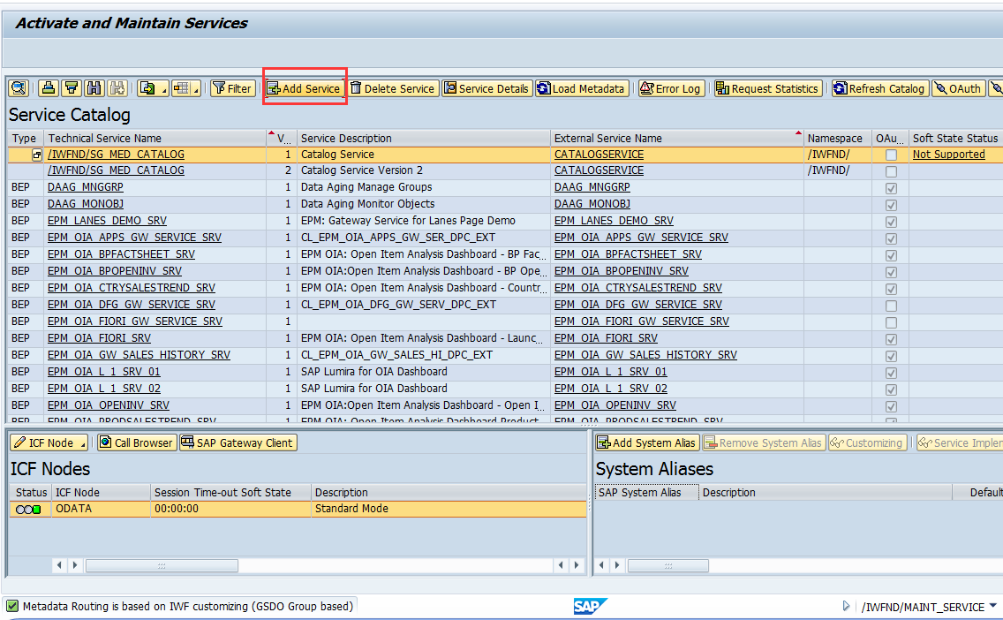
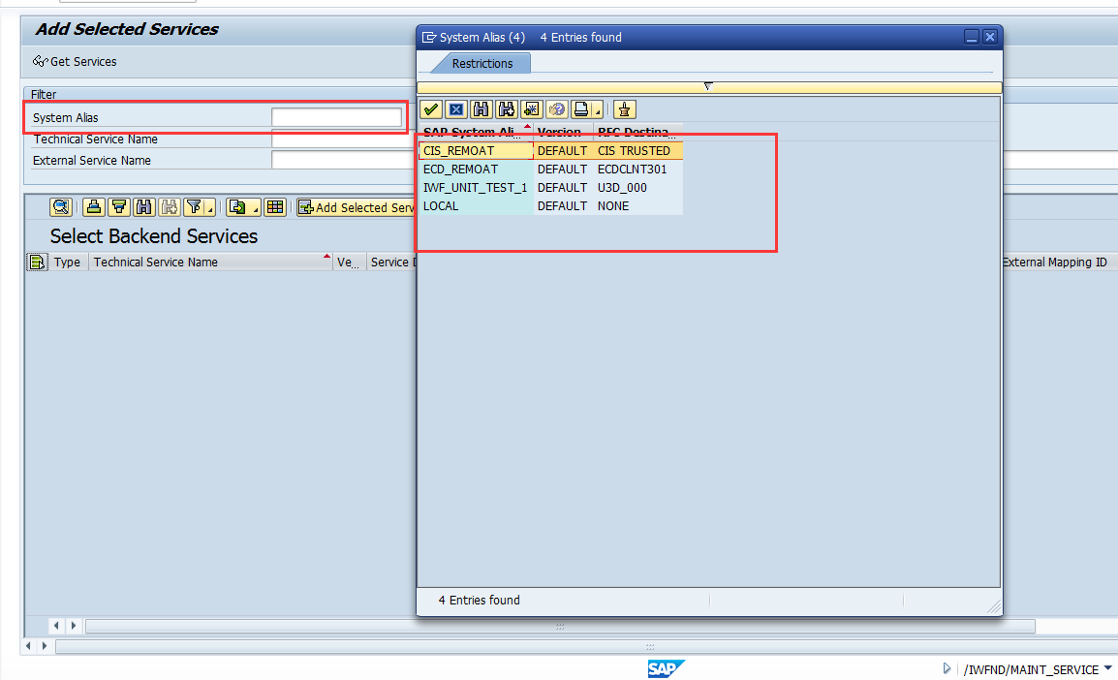
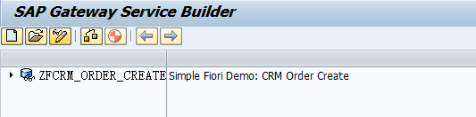
SAP Fiori Development Prepare---Back-end
1
Involved basis to configure the connection between Gateway and back-end system
After the configuration you can add the service
Make sure you have the authority of t-code: SEGW
2
3

Slide 11
Agenda
After this course, you will understand:
How to Develop Fiori app
SAP Fiori Introduction
SAP Fiori Architecture Overview
SAP Fiori Development Prepare
Back-end Development
Front-end Development
Helpful Resource in SCN

Slide 12
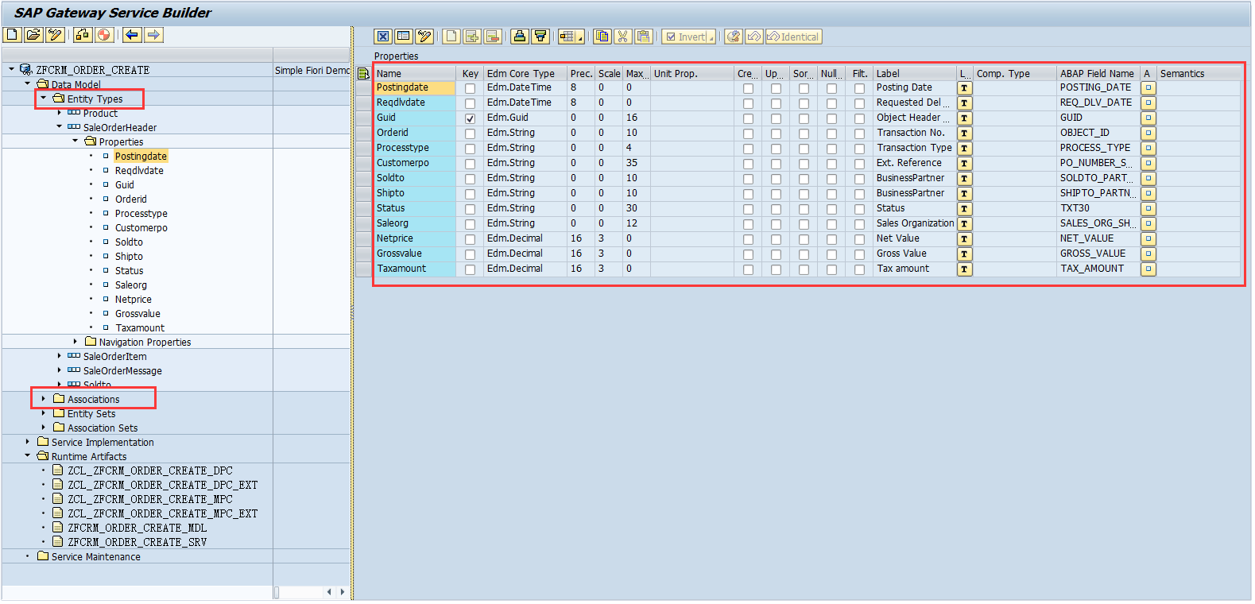
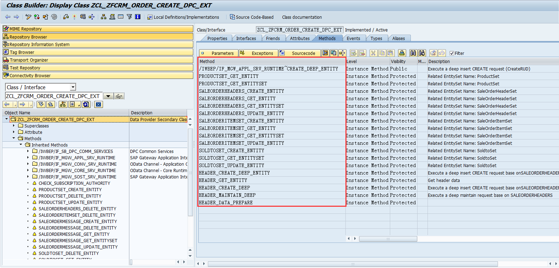
Back-end Development---SEGW
1
SEGW create gateway server
We add our main logic in the DPC_EXT class, our data type in MPC_EXT class
2

Slide 13
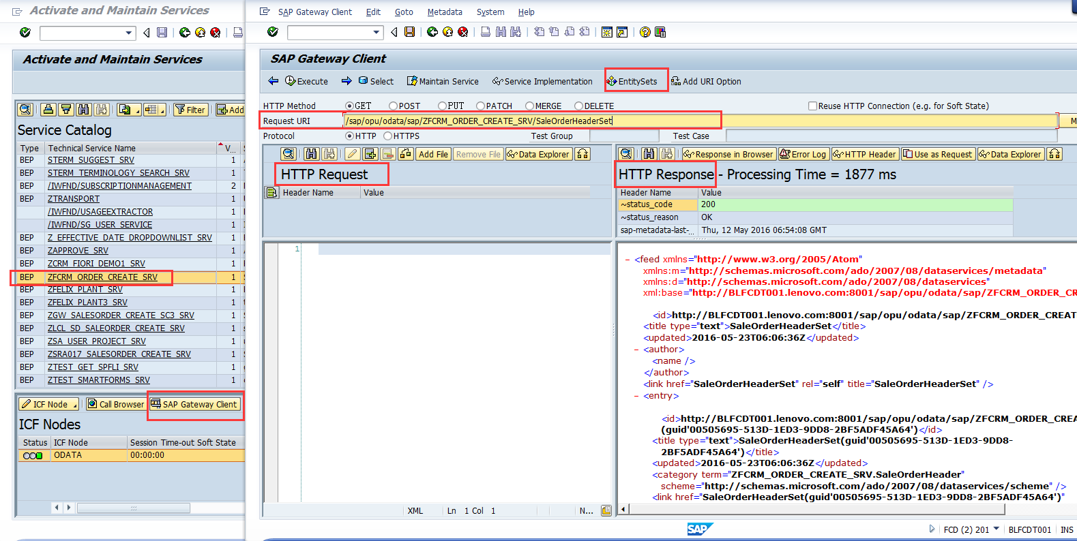
Back-end Development---Odata service
1
T-code: /N/IWFND/MAINT_SERVICE to test the Odata URL
The Response xml data
GET: Read Entity/Read Entity Set
POST: Create Entity
PUT: Update Entity
2
HTTP Request must be XML format you can get the XML form UI when create or update the entity

Slide 14
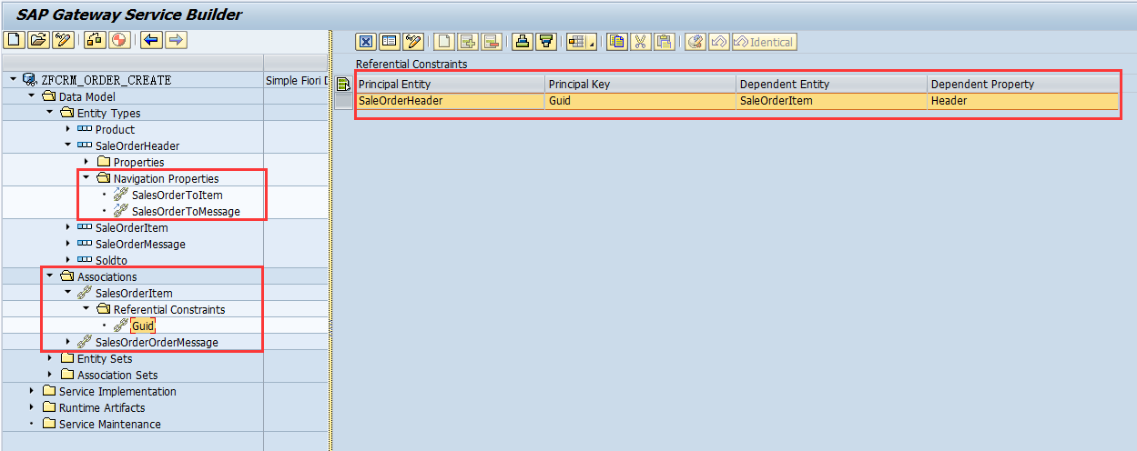
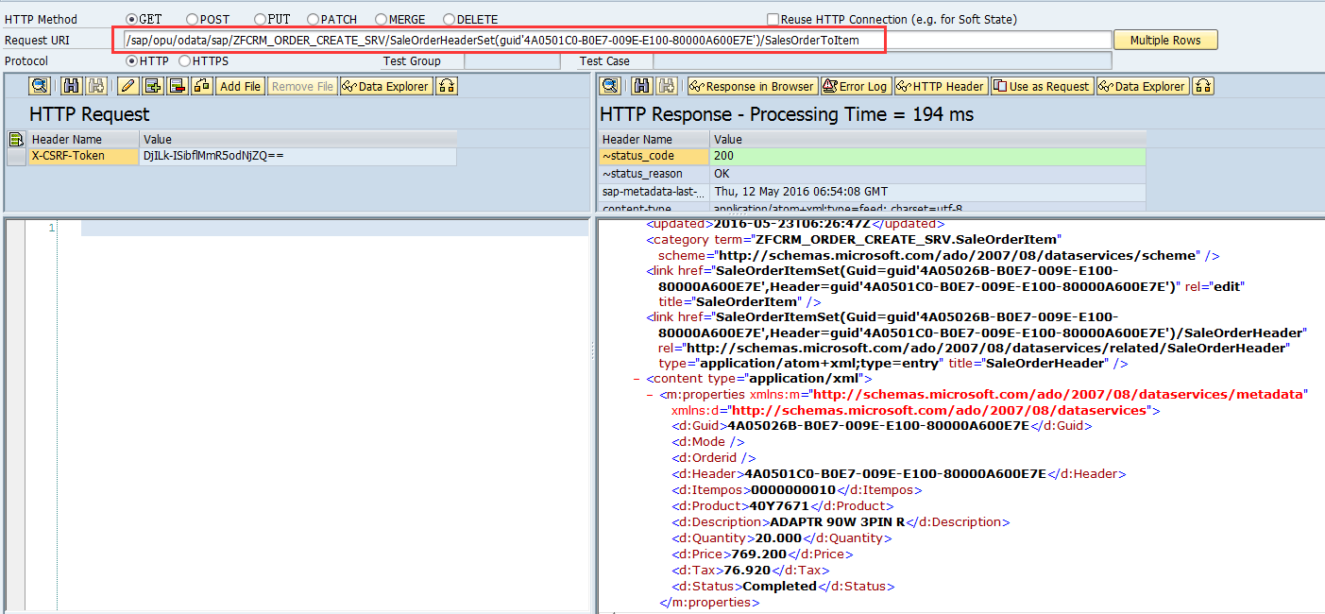
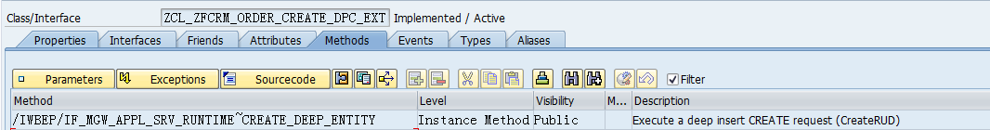
Back-end Development---Association
Create Association
Test the association
Redifine method:CREATE_DEEP_ENTITY to get header and item data form UI
1
2
3

Slide 15
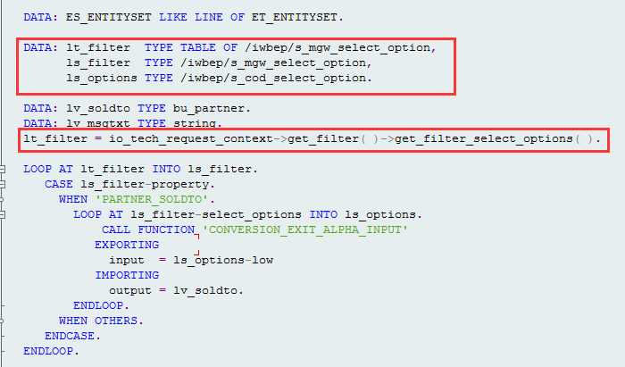
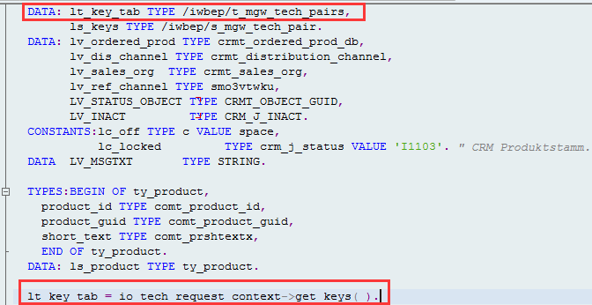
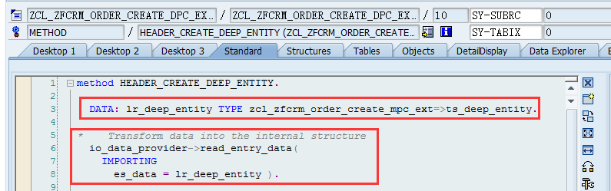
Back-end Development---Data transfer
Get the filter parameter form UI
Get the key field and value form UI
Get the input data form UI
1
2
3

Slide 16
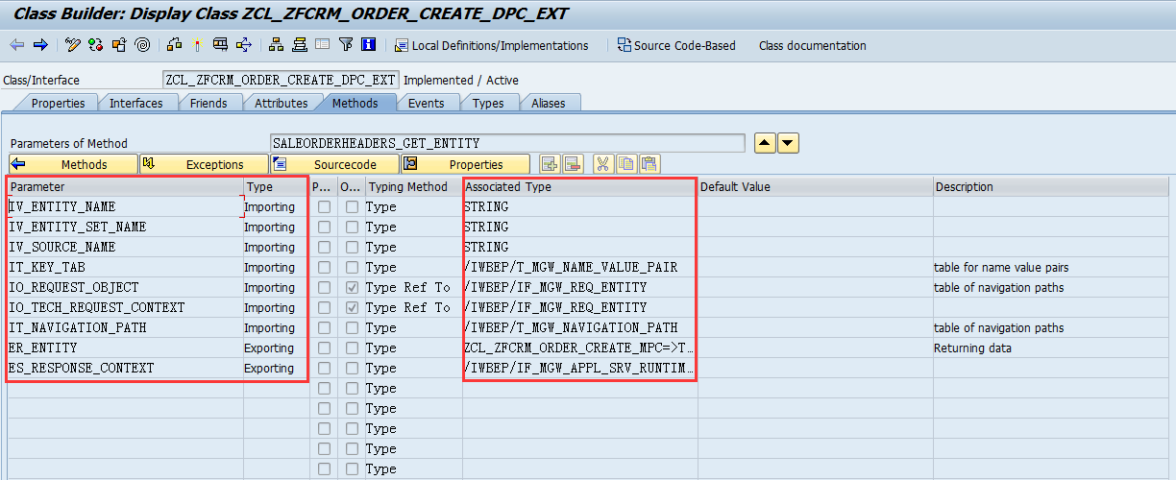
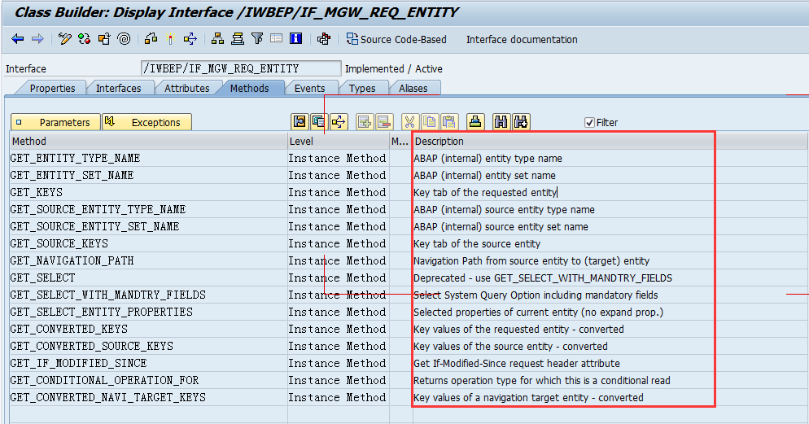
Back-end Development---Data transfer
Check the parameter of the method
Check the description of the importing parameter to find out what method you should use.
1
2
3

Slide 17
Agenda
After this course, you will understand:
How to Develop Fiori app
SAP Fiori Introduction
SAP Fiori Architecture Overview
SAP Fiori Development Prepare
Back-end Development
Front-end Development
Helpful Resource in SCN

Slide 18
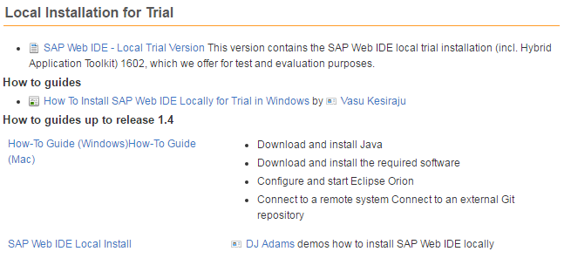
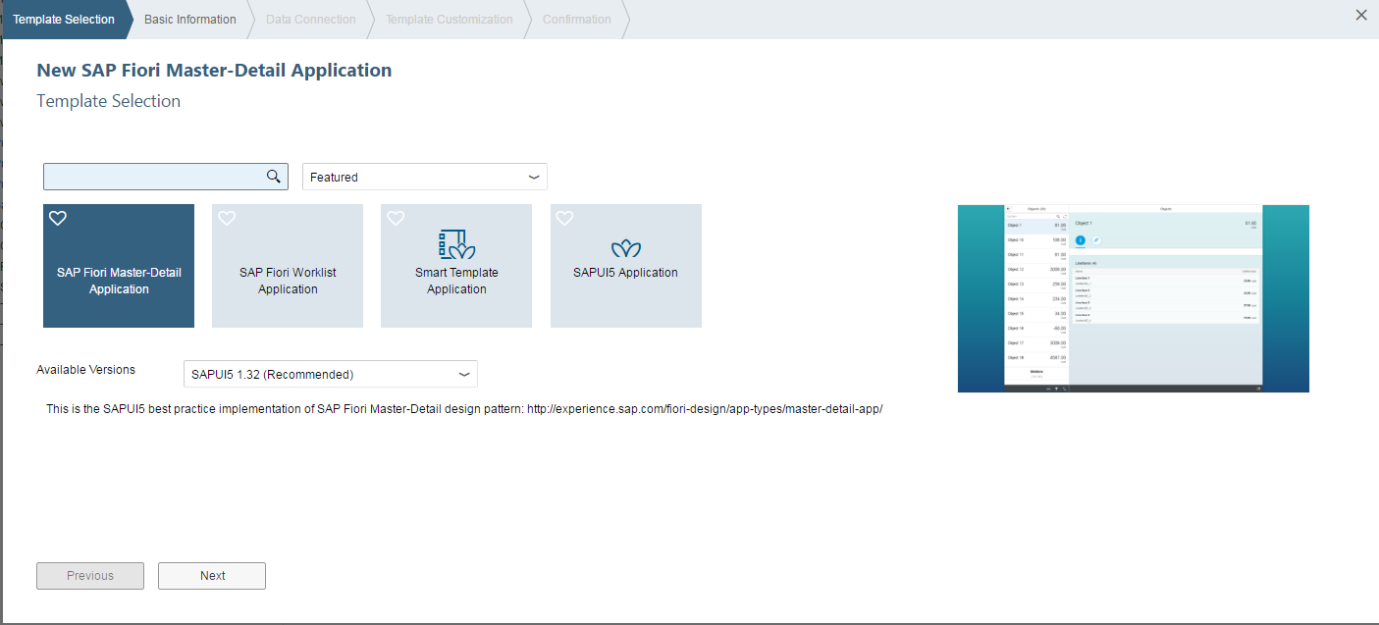
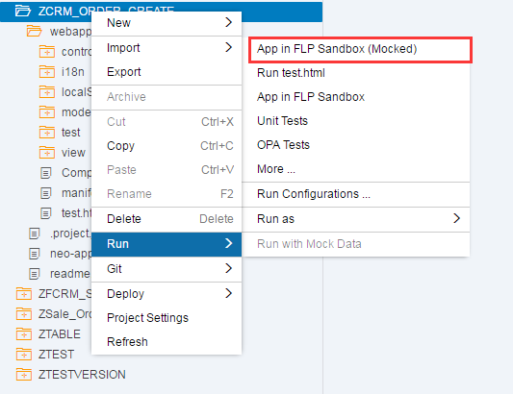
Front-end Development---WEB IDE
You can build the Fiori app with template and test locally
Download the WEB IDE: http://scn.sap.com/docs/DOC-55465

Slide 19
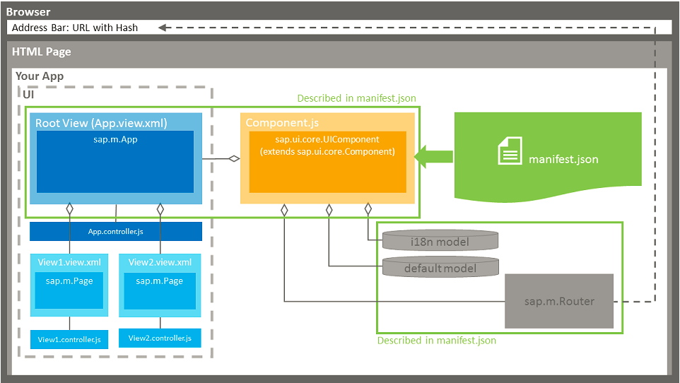
Front-end Development---App Architecture
Component is the core file of the app
Commom file
Your UI view and controller
3
1
2

Slide 20
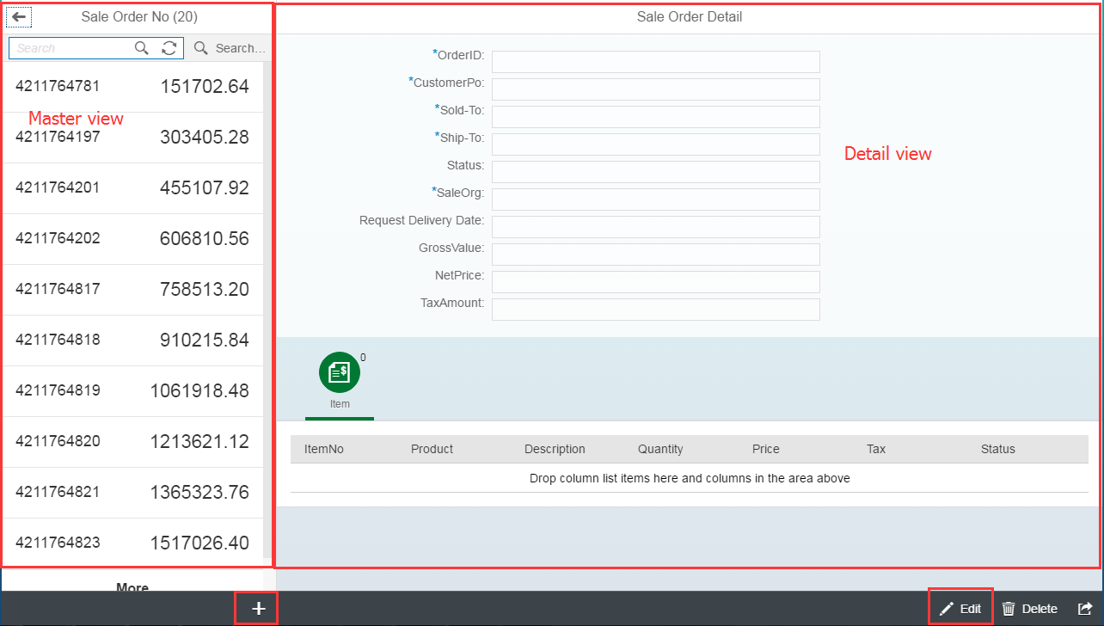
Front-end Development---Demo Architecture
FLP
Component
App
Master
Detail
Entity

Slide 21
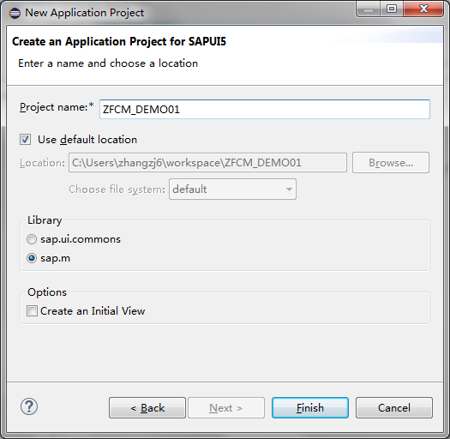
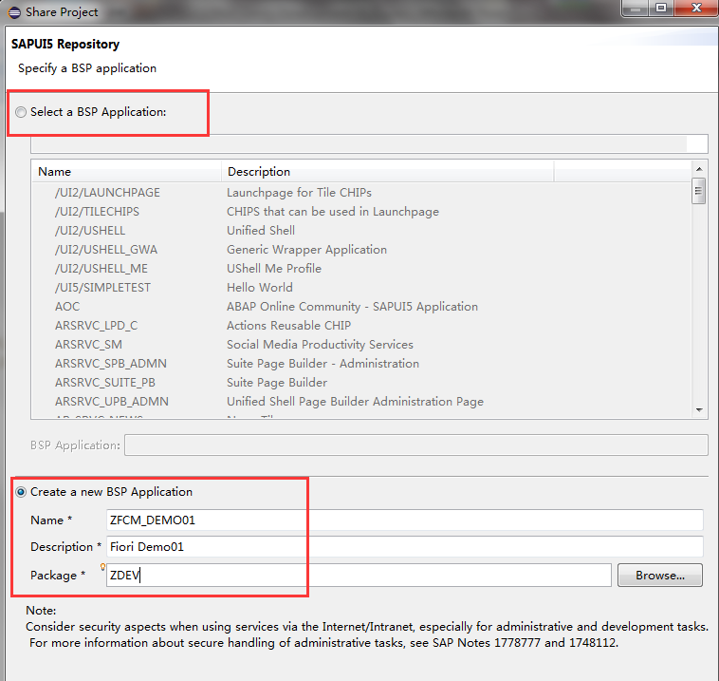
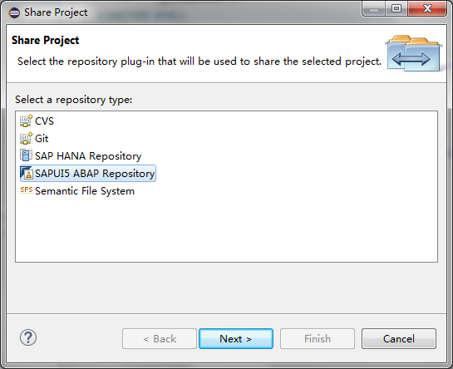
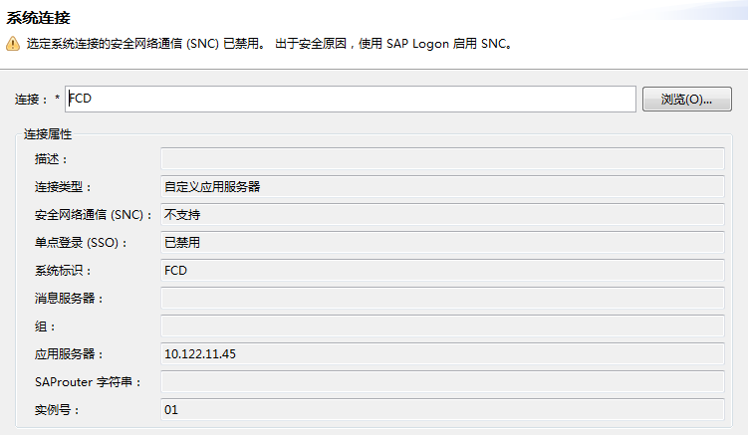
Front-end Development---Project Create
Create UI5 applicaiton
Commit to gateway
Develop your logic in view and controller

Slide 22
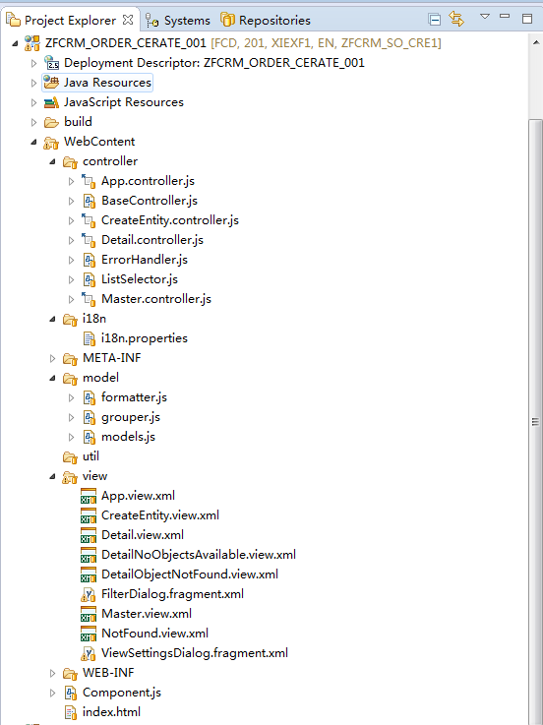
Front-end Development---Project Development
Project and BSP object in FCD
All controller
Language package
Custom JS file
All view
component

Slide 23
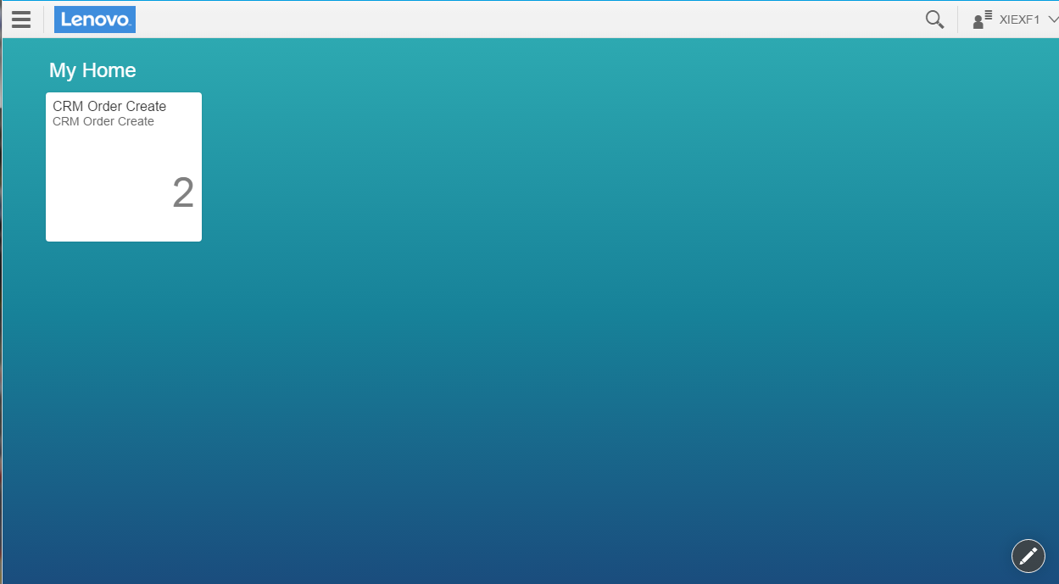
Front-end Development----FLP Configuration
Gateway t-code:/N /UI2/FLP enter the FLP
Detail step please check this doc

Slide 24
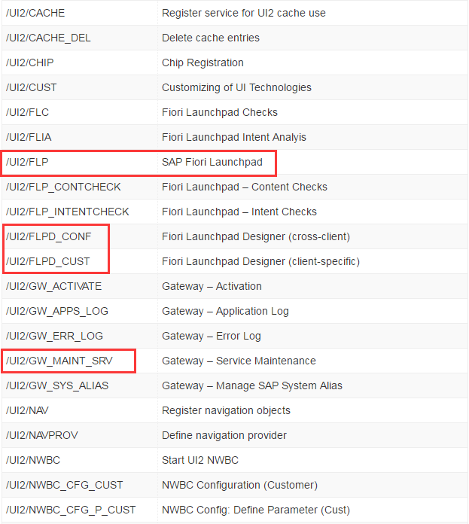
Front-end Development----FLP t-code
http://www.keytosmart.com/list-sap-fiori-tcodes/
Add the /N ahead the t-code

Slide 25
Agenda
After this course, you will understand:
How to Develop Fiori app
SAP Fiori Introduction
SAP Fiori Architecture Overview
SAP Fiori Development Prepare
Back-end Development
Front-end Development
Helpful Resource in SCN

Slide 26
Helpful Resource in SCN
1.Front-end Development:
http://scn.sap.com/community/fiori/blog/2016/01/14/fiori-crud-end-to-end-scenario
http://scn.sap.com/community/developer-center/front-end/blog/2015/02/18/demonstration-code-for-navigation-and-routing-in-sapui5
2.Back-end Development:
http://scn.sap.com/community/fiori/blog/2015/06/18/an-example-of-end-to-end-extension-on-crm-fiori-application--part1
http://scn.sap.com/community/gateway/blog/2014/03/06/let-s-code-crudq-and-function-import-operations-in-odata-service
http://scn.sap.com/community/gateway/blog/2014/09/24/lets-code-associationnavigation-and-data-provider-expand-in-odata-service
http://scn.sap.com/community/gateway/blog/2014/04/27/step-by-step-development-guide-for-createdeepentity-operation

